Slide 1


Control Flow
Chris Piech
CS106A, Stanford University

Slide 2

CS106A

Slide 3


Karel the Robot
s
* While Karel is in Java, when you program your Karel assignment we ask that you stick to the concepts in the course reader
Notes:
Tomorrow you will learn that Karel is actually a very gentle introduction to programming

Slide 4


First Challenge
3
+
+
+
+
2
+
+
+
+
1
+
+
+
+
1
2
3
4

Slide 5
Anatomy of a Program
import stanford.karel.*;
public class OurKarelProgram extends Karel {
public void run() {
move();
pickBeeper();
move();
turnLeft();
move();
turnRight();
move();
putBeeper();
move();
}
private void turnRight() {
turnLeft();
turnLeft();
turnLeft();
}
}
This is the program's source code

Slide 6
Anatomy of a Program
import stanford.karel.*;
public class OurKarelProgram extends Karel {
public void run() {
move();
pickBeeper();
move();
turnLeft();
move();
turnRight();
move();
putBeeper();
move();
}
private void turnRight() {
turnLeft();
turnLeft();
turnLeft();
}
}
This piece of the program's source code is called a method.

Slide 7
Anatomy of a Program
import stanford.karel.*;
public class OurKarelProgram extends Karel {
public void run() {
move();
pickBeeper();
move();
turnLeft();
move();
turnRight();
move();
putBeeper();
move();
}
private void turnRight() {
turnLeft();
turnLeft();
turnLeft();
}
}
x
This line of code gives the name of the method
(here, run)

Slide 8
Anatomy of a Program
import stanford.karel.*;
public class OurKarelProgram extends Karel {
public void run() {
move();
pickBeeper();
move();
turnLeft();
move();
turnRight();
move();
putBeeper();
move();
}
private void turnRight() {
turnLeft();
turnLeft();
turnLeft();
}
}
This line of code gives the name of the method
(here, turnRight)

Slide 9
Anatomy of a Program
import stanford.karel.*;
public class OurKarelProgram extends Karel {
public void run() {
move();
pickBeeper();
move();
turnLeft();
move();
turnRight();
move();
putBeeper();
move();
}
private void turnRight() {
turnLeft();
turnLeft();
turnLeft();
}
}
This is called an import statement. It tells Java what Karel is.

Slide 10
Anatomy of a Program
import stanford.karel.*;
public class OurKarelProgram extends Karel {
public void run() {
move();
pickBeeper();
move();
turnLeft();
move();
turnRight();
move();
putBeeper();
move();
}
private void turnRight() {
turnLeft();
turnLeft();
turnLeft();
}
}
This is called a code block

Slide 11
Anatomy of a Program
import stanford.karel.*;
public class OurKarelProgram extends Karel {
public void run() {
move();
pickBeeper();
move();
turnLeft();
move();
turnRight();
move();
putBeeper();
move();
}
private void turnRight() {
turnLeft();
turnLeft();
turnLeft();
}
}

Slide 12
Anatomy of a Program
import stanford.karel.*;
public class OurKarelProgram extends Karel {
public void run() {
move();
pickBeeper();
move();
turnLeft();
move();
turnRight();
move();
putBeeper();
move();
}
private void turnRight() {
turnLeft();
turnLeft();
turnLeft();
}
}

Slide 13
Anatomy of a Program
import stanford.karel.*;
public class OurKarelProgram extends Karel {
public void run() {
move();
pickBeeper();
move();
turnLeft();
move();
turnRight();
move();
putBeeper();
move();
}
private void turnRight() {
turnLeft();
turnLeft();
turnLeft();
}
}

Slide 14
Anatomy of a Program
import stanford.karel.*;
public class OurKarelProgram extends Karel {
public void run() {
move();
pickBeeper();
move();
turnLeft();
move();
turnRight();
move();
putBeeper();
move();
}
private void turnRight() {
turnLeft();
turnLeft();
turnLeft();
}
}

Slide 15
Anatomy of a Program
import stanford.karel.*;
public class OurKarelProgram extends Karel {
public void run() {
move();
pickBeeper();
move();
turnLeft();
move();
turnRight();
move();
putBeeper();
move();
}
private void turnRight() {
turnLeft();
turnLeft();
turnLeft();
}
}
The run method is “public” so that Eclipse can call it.

Slide 16
Anatomy of a Program
import stanford.karel.*;
public class OurKarelProgram extends Karel {
public void run() {
move();
pickBeeper();
move();
turnLeft();
move();
turnRight();
move();
putBeeper();
move();
}
private void turnRight() {
turnLeft();
turnLeft();
turnLeft();
}
}
The turnRight method is “private” to indicate it is only visible to our current program.

Slide 17

Method Definition
This adds a new command to Karels vocabulary
private void name() {
statements in the method body
}

Slide 18
Decomposition of Hard Tasks

Slide 19


Today’s Goal
Code using loops and conditions
Trace programs that use loops and conditions

Slide 20


Today’s Route
You are here
Control
Flow
If/Else
If
While
Loops
For
Loops
The River of Java

Slide 21
For loops,
While loops,
If/Else statements

Slide 22
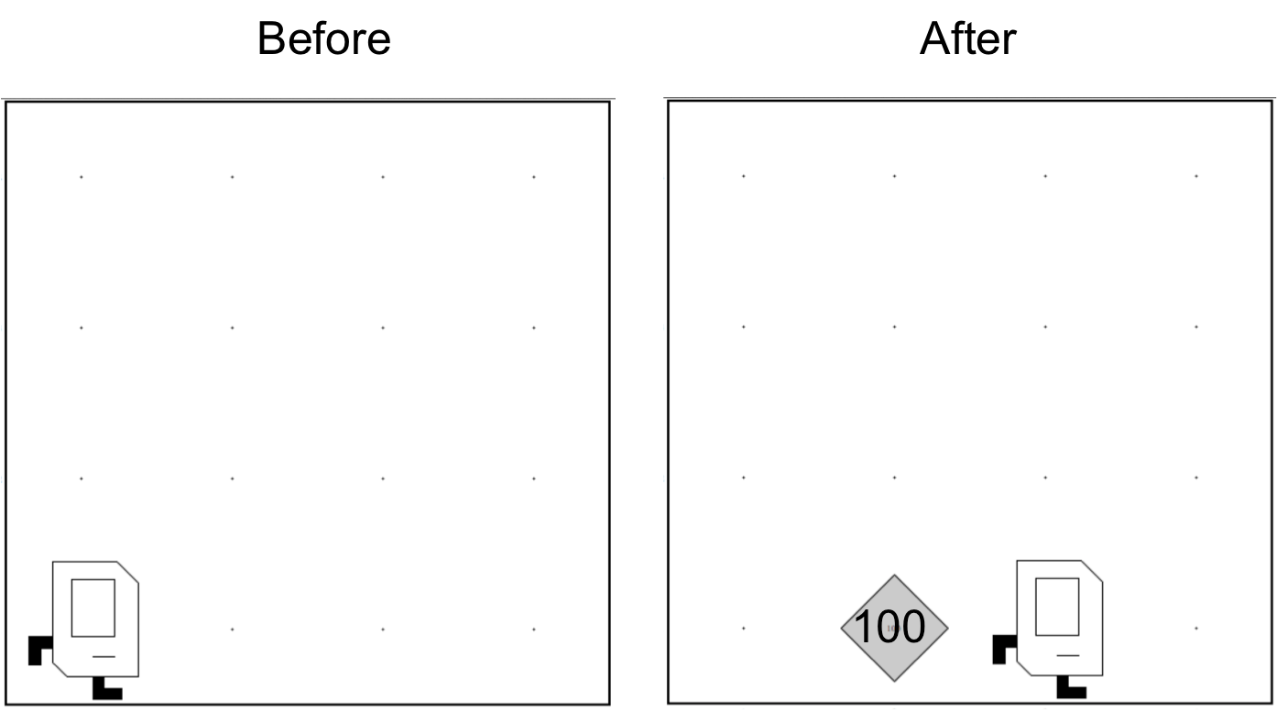
Place 99 beepers?
99

Slide 23
Place 99 beepers
public class Place99Beepers extends SuperKarel {
public void run() {
move();
for(int i = 0; i < 99; i++) {
putBeeper();
}
move();
}
}
This “for loop” repeats the code in its “body” 99 times

Slide 24

Place Beeper Square
public class BeeperSquare extends SuperKarel {
public void run() {
for(int i = 0; i < 4; i++) {
putBeeper();
move();
turnLeft();
}
}
}

Slide 25
Place Beeper Square
public class BeeperSquare extends SuperKarel {
public void run() {
for(int i = 0; i < 4; i++) {
putBeeper();
move();
turnLeft();
}
}
}
First time through the loop

Slide 26

Place Beeper Square
public class BeeperSquare extends SuperKarel {
public void run() {
for(int i = 0; i < 4; i++) {
putBeeper();
move();
turnLeft();
}
}
}
First time through the loop

Slide 27
Place Beeper Square
public class BeeperSquare extends SuperKarel {
public void run() {
for(int i = 0; i < 4; i++) {
putBeeper();
move();
turnLeft();
}
}
}
First time through the loop

Slide 28
Place Beeper Square
public class BeeperSquare extends SuperKarel {
public void run() {
for(int i = 0; i < 4; i++) {
putBeeper();
move();
turnLeft();
}
}
}
First time through the loop

Slide 29
Place Beeper Square
public class BeeperSquare extends SuperKarel {
public void run() {
for(int i = 0; i < 4; i++) {
putBeeper();
move();
turnLeft();
}
}
}
Second time through the loop

Slide 30
Place Beeper Square
public class BeeperSquare extends SuperKarel {
public void run() {
for(int i = 0; i < 4; i++) {
putBeeper();
move();
turnLeft();
}
}
}
Second time through the loop

Slide 31
Place Beeper Square
public class BeeperSquare extends SuperKarel {
public void run() {
for(int i = 0; i < 4; i++) {
putBeeper();
move();
turnLeft();
}
}
}
Second time through the loop

Slide 32
Place Beeper Square
public class BeeperSquare extends SuperKarel {
public void run() {
for(int i = 0; i < 4; i++) {
putBeeper();
move();
turnLeft();
}
}
}
Second time through the loop

Slide 33
Place Beeper Square
public class BeeperSquare extends SuperKarel {
public void run() {
for(int i = 0; i < 4; i++) {
putBeeper();
move();
turnLeft();
}
}
}
Third time through the loop

Slide 34
Place Beeper Square
public class BeeperSquare extends SuperKarel {
public void run() {
for(int i = 0; i < 4; i++) {
putBeeper();
move();
turnLeft();
}
}
}
Third time through the loop

Slide 35
Place Beeper Square
public class BeeperSquare extends SuperKarel {
public void run() {
for(int i = 0; i < 4; i++) {
putBeeper();
move();
turnLeft();
}
}
}
Third time through the loop

Slide 36
Place Beeper Square
public class BeeperSquare extends SuperKarel {
public void run() {
for(int i = 0; i < 4; i++) {
putBeeper();
move();
turnLeft();
}
}
}
Third time through the loop

Slide 37
Place Beeper Square
public class BeeperSquare extends SuperKarel {
public void run() {
for(int i = 0; i < 4; i++) {
putBeeper();
move();
turnLeft();
}
}
}
Fourth time through the loop

Slide 38
Place Beeper Square
public class BeeperSquare extends SuperKarel {
public void run() {
for(int i = 0; i < 4; i++) {
putBeeper();
move();
turnLeft();
}
}
}
Fourth time through the loop

Slide 39
Place Beeper Square
public class BeeperSquare extends SuperKarel {
public void run() {
for(int i = 0; i < 4; i++) {
putBeeper();
move();
turnLeft();
}
}
}
Fourth time through the loop

Slide 40
Place Beeper Square
public class BeeperSquare extends SuperKarel {
public void run() {
for(int i = 0; i < 4; i++) {
putBeeper();
move();
turnLeft();
}
}
}
Fourth time through the loop

Slide 41
Place Beeper Square
public class BeeperSquare extends SuperKarel {
public void run() {
for(int i = 0; i < 4; i++) {
putBeeper();
move();
turnLeft();
}
}
}

Slide 42
Exciting!

Slide 43

Aside: Super Karel
public class BeeperSquare extends SuperKarel {
public void run() {
for(int i = 0; i < 4; i++) {
putBeeper();
move();
turnLeft();
}
}
}

Slide 44
Aside: Super Karel
public class BeeperSquare extends SuperKarel {
public void run() {
// super karel has a few more commands
turnRight();
turnAround();
paintCorner(BLUE);
putBeeper();
move();
}
}

Slide 45
Next task

Slide 46
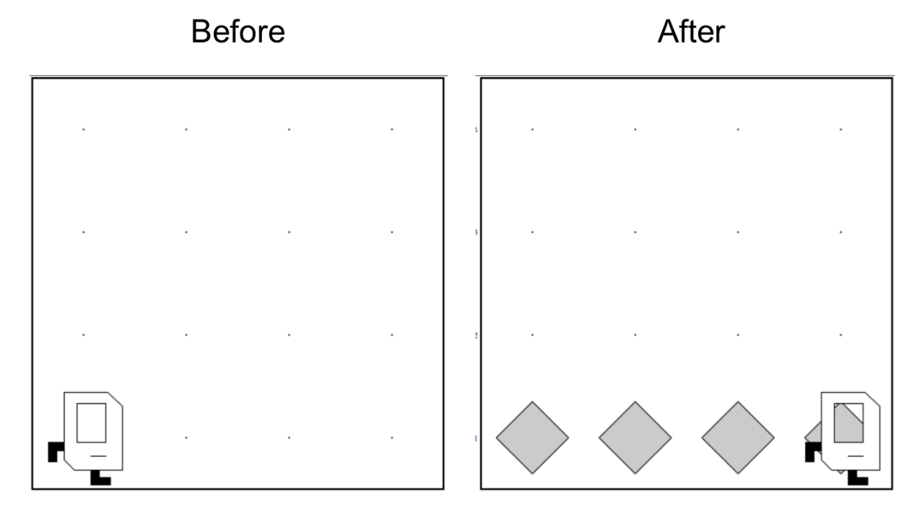
Place Beeper Line
Try and solve it!

Slide 47
Place Beeper Line
import stanford.karel.*;
public class BeeperLine extends SuperKarel {
public void run() {
for(int i = 0; i < 4; i++) {
putBeeper();
move();
}
}
}

Slide 48


Slide 49

Place Beeper Line
import stanford.karel.*;
public class BeeperLine extends SuperKarel {
public void run() {
for(int i = 0; i < 4; i++) {
putBeeper();
move();
}
}
}

Slide 50


Slide 51

Place Beeper Line
import stanford.karel.*;
public class BeeperLine extends SuperKarel {
public void run() {
for(int i = 0; i < 4; i++) {
putBeeper();
move();
}
}
}
What we want

Slide 52
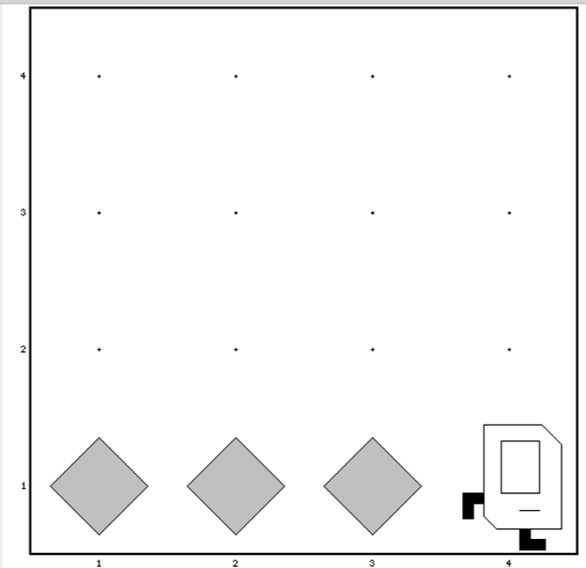
Place Beeper Line
import stanford.karel.*;
public class BeeperLine extends SuperKarel {
public void run() {
for(int i = 0; i < 3; i++) {
putBeeper();
move();
}
}
}

Slide 53

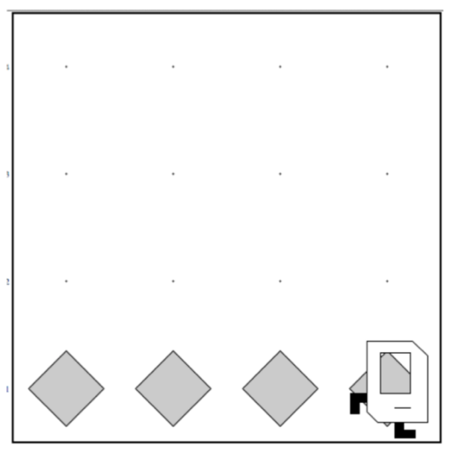
Place Beeper Line
import stanford.karel.*;
public class BeeperLine extends SuperKarel {
public void run() {
for(int i = 0; i < 3; i++) {
putBeeper();
move();
}
// extra put beeper
putBeeper();
}
}

Slide 54
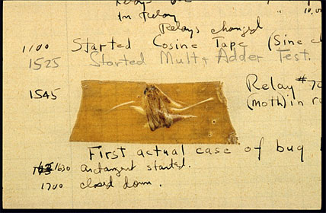
Actual Bug from Mark II Computer
Actual Bug from Marc II

Slide 55
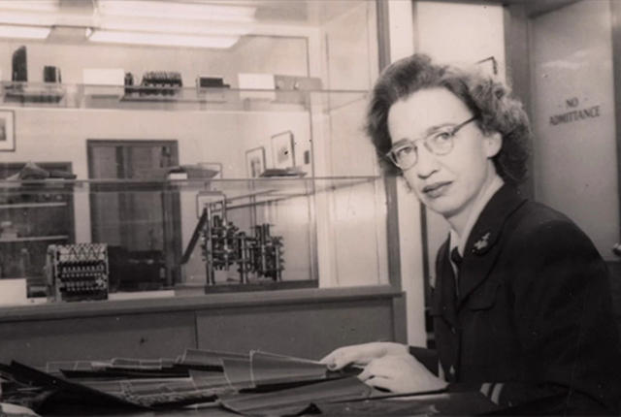
Grace Hopper

Slide 56
Fence Post Problem
* Also sometimes called an Off By One Error

Slide 57
Unstoppable

Slide 58
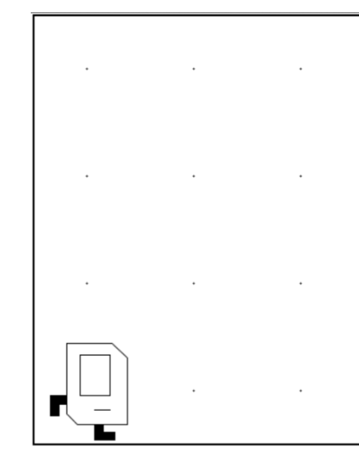
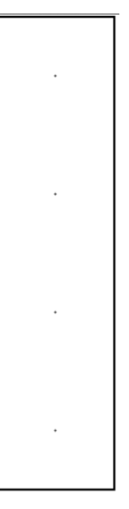
Don’t Know World Size
?

Slide 59
While Loop

Slide 60
While Loop
import stanford.karel.*;
public class BeeperLine extends SuperKarel {
public void run() {
// example while loop
while(condition) {
code to repeat
}
}
}

Slide 61
Possible Conditions
Test | Opposite | What it checks
frontIsClear() | frontIsBlocked() | Is there a wall in front of Karel?
leftIsClear() | leftIsBlocked() | Is there a wall to Karel’s left?
rightIsClear() | rightIsBlocked() | Is there a wall to Karel’s right?
beepersPresent() | noBeepersPresent() | Are there beepers on this corner?
beepersInBag() | noBeepersInBag() | Any there beepers in Karel’s bag?
facingNorth() | notFacingNorth() | Is Karel facing north?
facingEast() | notFacingEast() | Is Karel facing east?
facingSouth() | notFacingSouth() | Is Karel facing south?
facingWest() | notFacingWest() | Is Karel facing west?
This is Table 1 on page 18 of the Karel coursereader.

Slide 62
Move to Wall
import stanford.karel.*;
public class BeeperLine extends SuperKarel {
public void run() {
// example while loop
while(condition) {
code to repeat
}
}
}

Slide 63
Move to Wall
import stanford.karel.*;
public class BeeperLine extends SuperKarel {
public void run() {
// example while loop
while(frontIsClear()) {
code to repeat
}
}
}

Slide 64
Move to Wall
import stanford.karel.*;
public class BeeperLine extends SuperKarel {
public void run() {
// example while loop
while(frontIsClear()) {
move();
}
}
}

Slide 65
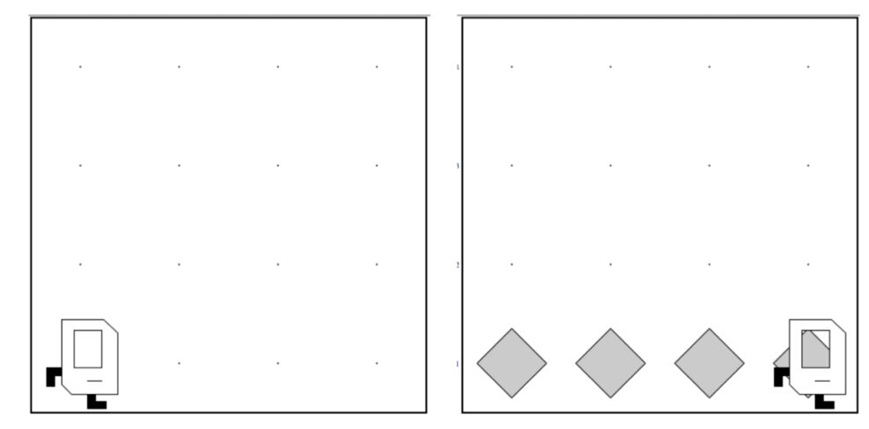
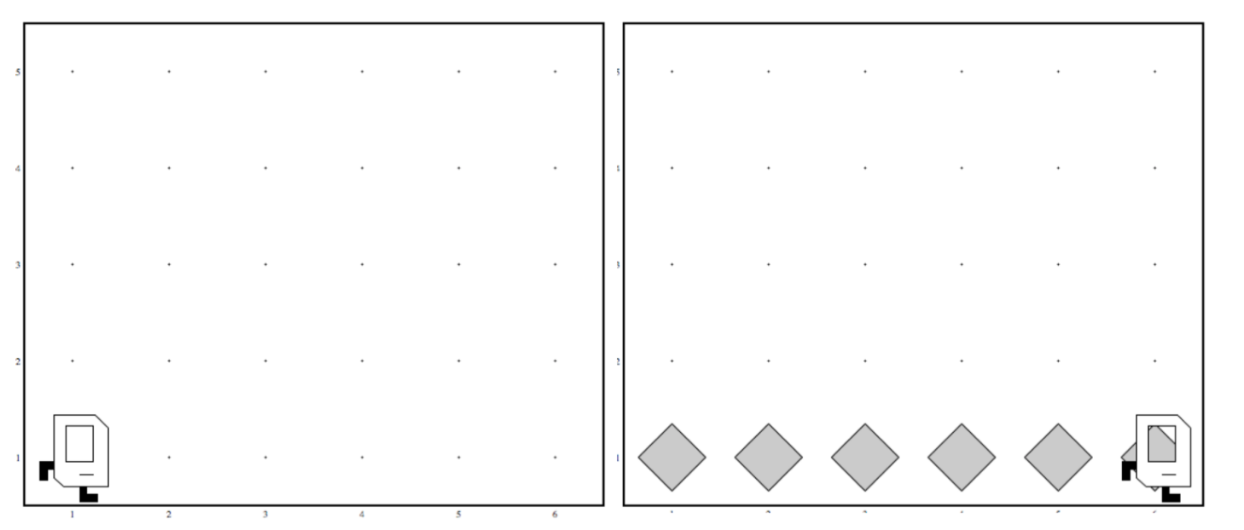
Code that Works in Any World
Before
After
Before
After

Slide 66
Place Beeper Line
import stanford.karel.*;
public class BeeperLine extends SuperKarel {
public void run() {
// example while loop
while(frontIsClear()) {
move();
}
}
}

Slide 67
Place Beeper Line
import stanford.karel.*;
public class BeeperLine extends SuperKarel {
public void run() {
// example while loop
while(frontIsClear()) {
putBeeper();
move();
}
}
}

Slide 68
Place Beeper Line
import stanford.karel.*;
public class BeeperLine extends SuperKarel {
public void run() {
// example while loop
while(frontIsClear()) {
putBeeper();
move();
}
// extra put beeper
putBeeper();
}
}

Slide 69
Place Beeper Line
import stanford.karel.*;
public class BeeperLine extends SuperKarel {
public void run() {
// example while loop
while(frontIsClear()) {
putBeeper();
move();
}
// extra put beeper
putBeeper();
}
}

Slide 70
Place Beeper Line
import stanford.karel.*;
public class BeeperLine extends SuperKarel {
public void run() {
// example while loop
while(frontIsClear()) {
putBeeper();
move();
}
// extra put beeper
putBeeper();
}
}

Slide 71
Place Beeper Line
import stanford.karel.*;
public class BeeperLine extends SuperKarel {
public void run() {
// example while loop
while(frontIsClear()) {
putBeeper();
move();
}
// extra put beeper
putBeeper();
}
}

Slide 72
Place Beeper Line
import stanford.karel.*;
public class BeeperLine extends SuperKarel {
public void run() {
// example while loop
while(frontIsClear()) {
putBeeper();
move();
}
// extra put beeper
putBeeper();
}
}

Slide 73
Place Beeper Line
import stanford.karel.*;
public class BeeperLine extends SuperKarel {
public void run() {
// example while loop
while(frontIsClear()) {
putBeeper();
move();
}
// extra put beeper
putBeeper();
}
}

Slide 74
Place Beeper Line
import stanford.karel.*;
public class BeeperLine extends SuperKarel {
public void run() {
// example while loop
while(frontIsClear()) {
putBeeper();
move();
}
// extra put beeper
putBeeper();
}
}

Slide 75
Place Beeper Line
import stanford.karel.*;
public class BeeperLine extends SuperKarel {
public void run() {
// example while loop
while(frontIsClear()) {
putBeeper();
move();
}
// extra put beeper
putBeeper();
}
}

Slide 76
Place Beeper Line
import stanford.karel.*;
public class BeeperLine extends SuperKarel {
public void run() {
// example while loop
while(frontIsClear()) {
putBeeper();
move();
}
// extra put beeper
putBeeper();
}
}

Slide 77
Place Beeper Line
import stanford.karel.*;
public class BeeperLine extends SuperKarel {
public void run() {
// example while loop
while(frontIsClear()) {
putBeeper();
move();
}
// extra put beeper
putBeeper();
}
}

Slide 78
Place Beeper Line
import stanford.karel.*;
public class BeeperLine extends SuperKarel {
public void run() {
// example while loop
while(frontIsClear()) {
putBeeper();
move();
}
// extra put beeper
putBeeper();
}
}

Slide 79
Place Beeper Line
import stanford.karel.*;
public class BeeperLine extends SuperKarel {
public void run() {
// example while loop
while(frontIsClear()) {
putBeeper();
move();
}
// extra put beeper
putBeeper();
}
}

Slide 80
Place Beeper Line
import stanford.karel.*;
public class BeeperLine extends SuperKarel {
public void run() {
// example while loop
while(frontIsClear()) {
putBeeper();
move();
}
// extra put beeper
putBeeper();
}
}

Slide 81
Place Beeper Line
import stanford.karel.*;
public class BeeperLine extends SuperKarel {
public void run() {
// example while loop
while(frontIsClear()) {
putBeeper();
move();
}
// extra put beeper
putBeeper();
}
}

Slide 83
Common misconception:

Slide 84
Place Beeper Line: Redux
import stanford.karel.*;
public class BeeperLine extends SuperKarel {
public void run() {
// place a first beeper
putBeeper();
// example while loop
while(frontIsClear()) {
move();
putBeeper();
}
}
}

Slide 85
Place Beeper Line: Redux
import stanford.karel.*;
public class BeeperLine extends SuperKarel {
public void run() {
// place a first beeper
putBeeper();
// example while loop
while(frontIsClear()) {
move();
putBeeper();
}
}
}

Slide 86
Place Beeper Line: Redux
import stanford.karel.*;
public class BeeperLine extends SuperKarel {
public void run() {
// place a first beeper
putBeeper();
// example while loop
while(frontIsClear()) {
move();
putBeeper();
}
}
}

Slide 87
Place Beeper Line: Redux
import stanford.karel.*;
public class BeeperLine extends SuperKarel {
public void run() {
// place a first beeper
putBeeper();
// example while loop
while(frontIsClear()) {
move();
putBeeper();
}
}
}

Slide 88
Place Beeper Line: Redux
import stanford.karel.*;
public class BeeperLine extends SuperKarel {
public void run() {
// place a first beeper
putBeeper();
// example while loop
while(frontIsClear()) {
move();
putBeeper();
}
}
}

Slide 89
Place Beeper Line: Redux
import stanford.karel.*;
public class BeeperLine extends SuperKarel {
public void run() {
// place a first beeper
putBeeper();
// example while loop
while(frontIsClear()) {
move();
putBeeper();
}
}
}

Slide 90
Place Beeper Line: Redux
import stanford.karel.*;
public class BeeperLine extends SuperKarel {
public void run() {
// place a first beeper
putBeeper();
// example while loop
while(frontIsClear()) {
move();
putBeeper();
}
}
}

Slide 91
Place Beeper Line: Redux
import stanford.karel.*;
public class BeeperLine extends SuperKarel {
public void run() {
// place a first beeper
putBeeper();
// example while loop
while(frontIsClear()) {
move();
putBeeper();
}
}
}

Slide 92
Place Beeper Line: Redux
import stanford.karel.*;
public class BeeperLine extends SuperKarel {
public void run() {
// place a first beeper
putBeeper();
// example while loop
while(frontIsClear()) {
move();
putBeeper();
}
}
}
This is incredibly important!

Slide 93
Place Beeper Line: Redux
import stanford.karel.*;
public class BeeperLine extends SuperKarel {
public void run() {
// place a first beeper
putBeeper();
// example while loop
while(frontIsClear()) {
move();
putBeeper();
}
}
}

Slide 94
Place Beeper Line: Redux
import stanford.karel.*;
public class BeeperLine extends SuperKarel {
public void run() {
// place a first beeper
putBeeper();
// example while loop
while(frontIsClear()) {
move();
putBeeper();
}
}
}

Slide 95
Place Beeper Line: Redux
import stanford.karel.*;
public class BeeperLine extends SuperKarel {
public void run() {
// place a first beeper
putBeeper();
// example while loop
while(frontIsClear()) {
move();
putBeeper();
}
}
}

Slide 96
Place Beeper Line: Redux
import stanford.karel.*;
public class BeeperLine extends SuperKarel {
public void run() {
// place a first beeper
putBeeper();
// example while loop
while(frontIsClear()) {
move();
putBeeper();
}
}
}

Slide 97
A program executes one line at a time.
The while loop checks its condition only at the start of the code block and before repeating.

Slide 98
Which Loop
Repeat Process
Know how many times
Don’t know how many times
For Loop
While Loop

Slide 99
What if you only want to repeat one time?

Slide 100
If statement

Slide 101
If Statement
import stanford.karel.*;
public class IfExample extends SuperKarel {
public void run() {
// example of an if statement
if(condition) {
code to run if condition is true
}
}
}

Slide 102
If Statement
import stanford.karel.*;
public class IfExample extends Pretend{
public void run() {
// example of an if statement
if(youLikeBeyonce()) {
makeSomeNoise();
}
}
}

Slide 103
If Statement
import stanford.karel.*;
public class IfExample extends SuperKarel{
public void run() {
safeMove();
}
private void safeMove() {
if(frontIsClear()) {
move();
}
}
}

Slide 104
If / Else Statement
import stanford.karel.*;
public class IfExample extends SuperKarel{
public void run() {
invertBeeper();
}
private void invertBeeper() {
if(beepersPresent()) {
pickBeeper();
} else {
putBeeper();
}
}
}

Slide 105
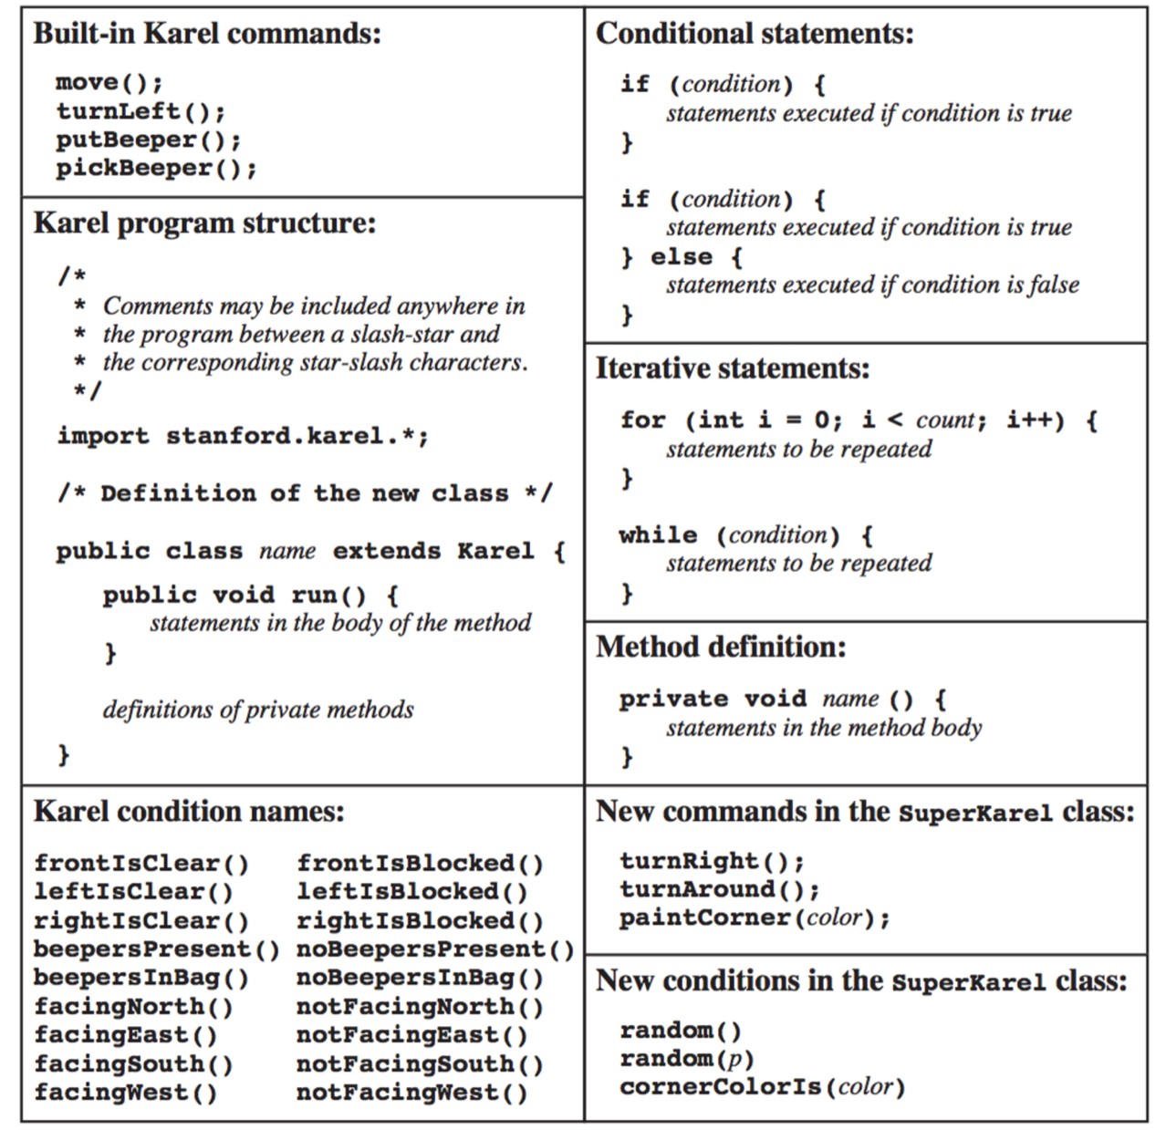
The Full Karel

Slide 106
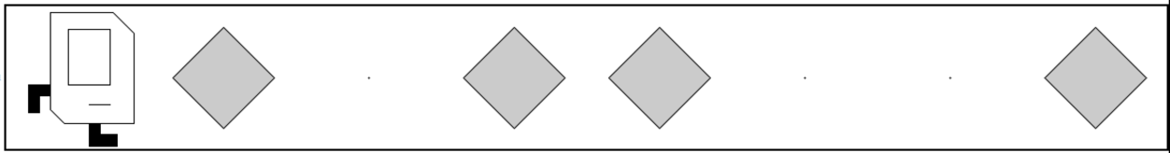
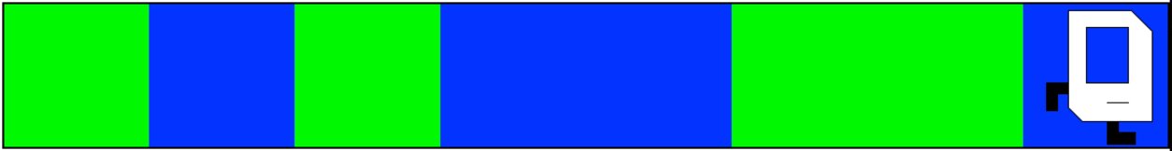
Random Painter
Before:
After:
Before:
After:

Slide 107
You just learned most of programming “control flow”

Slide 108
Today’s Goal
Code using loops and conditions
Trace programs that use loops and conditions

Slide 109
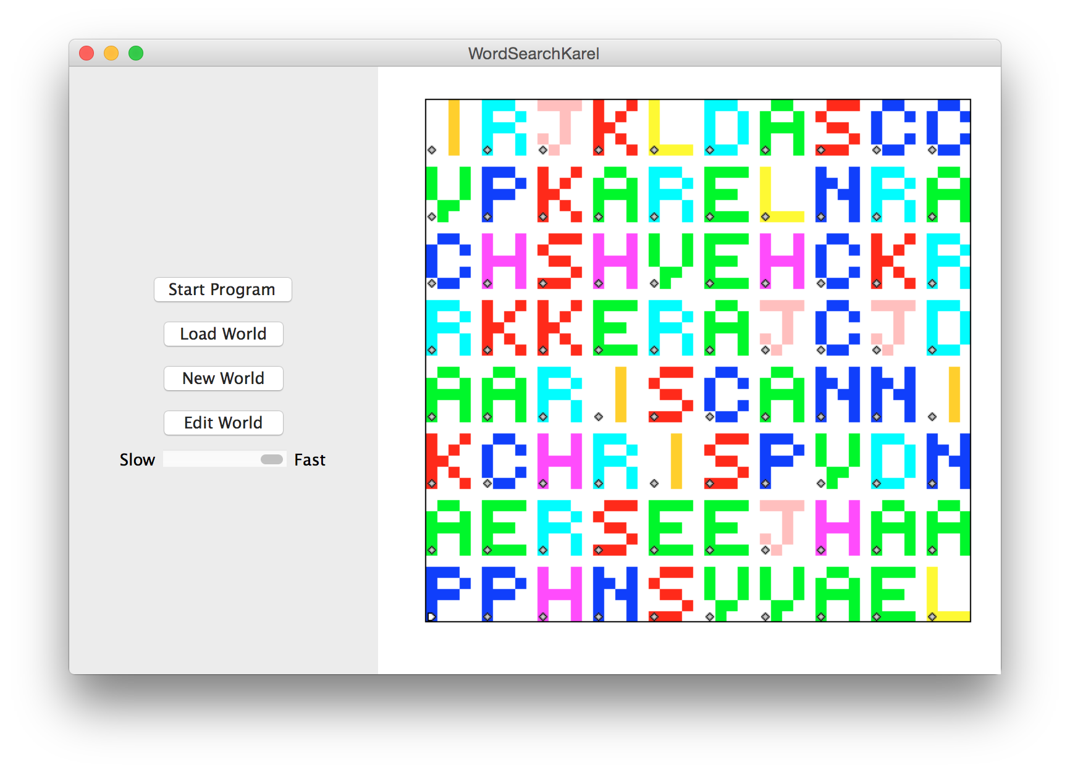

Slide 110
